Slide 1
Structures

Slide 2
Structures:
A structure is a collection of variables referenced under one name, providing a convenient means of keeping related information together. A structure declaration forms a template that can be used to create structure objects.
The variables that make up the structure are called members. Structure members are also commonly referred to as elements or fields.
The members of a structure are logically related.
The key word struct tells the compiler that a structure is being declared.

Slide 3
struct Student {
int id;
char name[50];
} ;
Declaration is terminated by a semicolon. This is because a structure declaration is a statement.
When a structure variable is declared, the compiler automatically allocates sufficient memory to accommodate all of its members.

Slide 4
General Form of A Structure Declaration :
struct tag {
type member-name;
type member-name;
type member-name;
.
.
.
} structure-variables;
Here either tag or structure-variables may be omitted, but not both.

Slide 5
Accessing Structure Members:
Individual members of a structure are accessed through the use of the (.) operator (dot operator).
The general form for accessing a member of a structure is :
object-name.member-name
struct Student{
int id;
char name[16];
} ;
int main (){
struct Student s1,s2;
s1.id = 10;
}

Slide 6
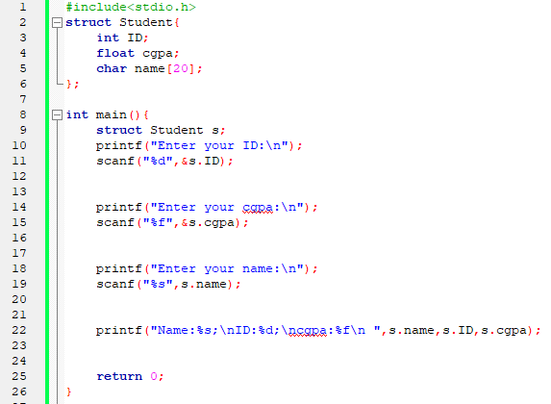
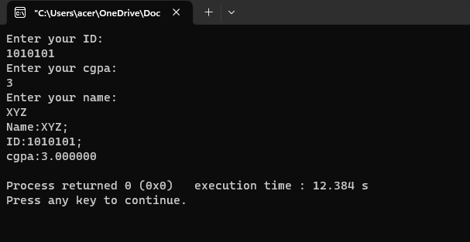

Slide 7
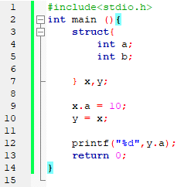
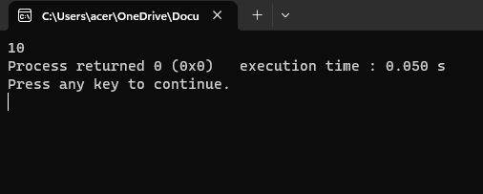
Structure Assignments :
The information contained in one structure can be assigned to another structure of the same type using a single assignment statement. We don’t need to assign the value of each member separately.

Slide 8
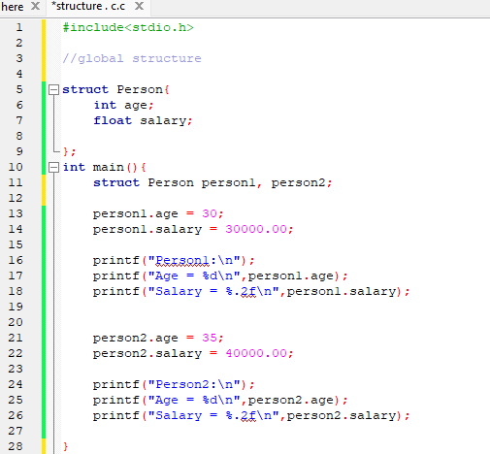
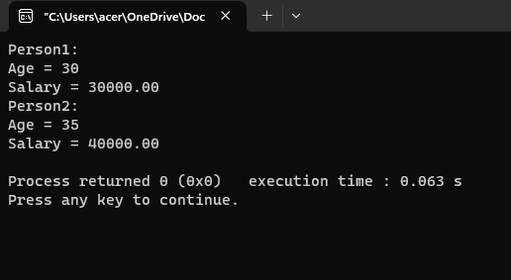

Slide 9
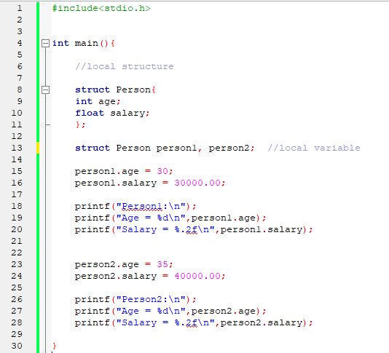

Slide 10
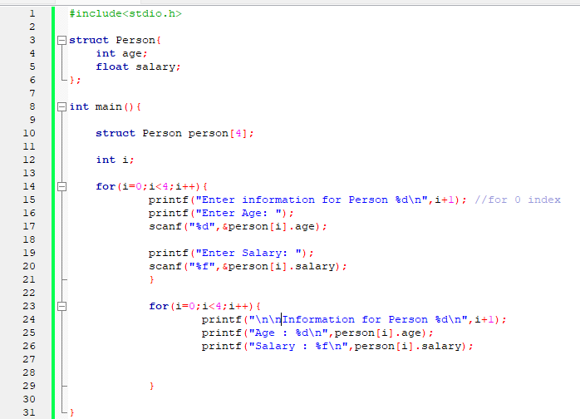
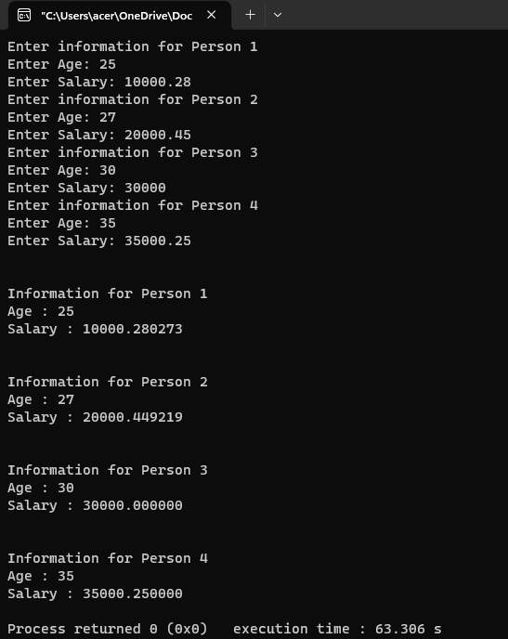
Array of Structure:

Slide 11
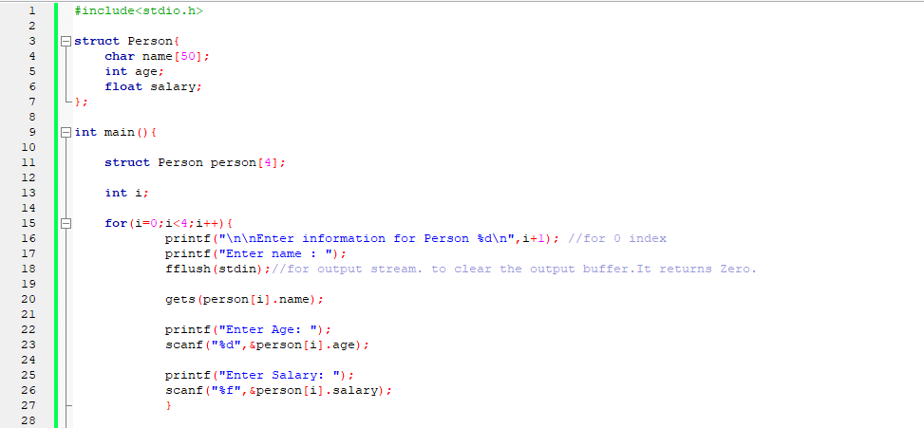
Array within Structure:

Slide 12
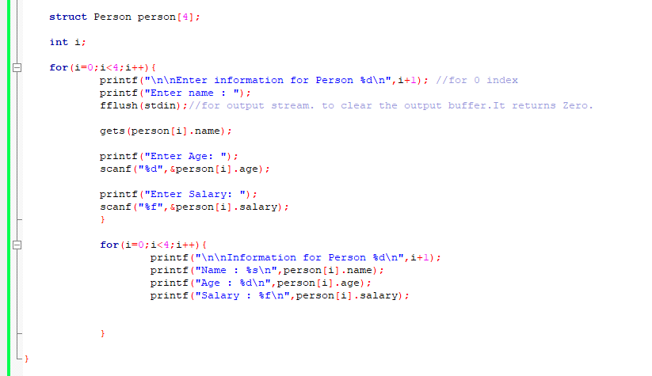

Slide 13
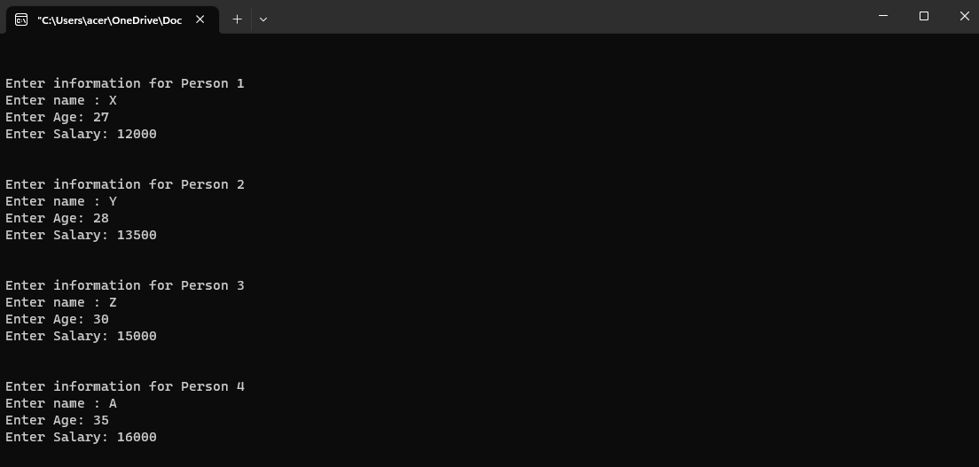

Slide 14
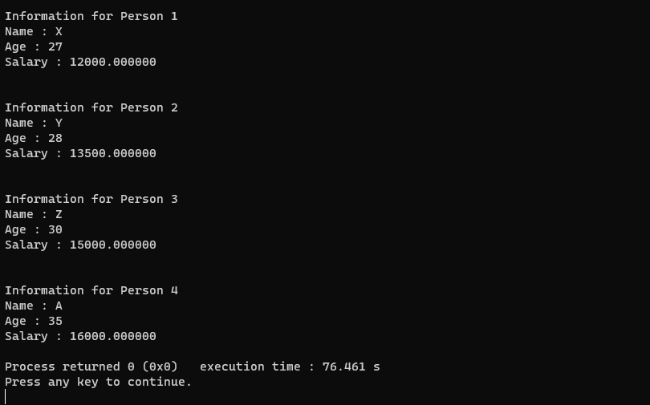

Slide 15
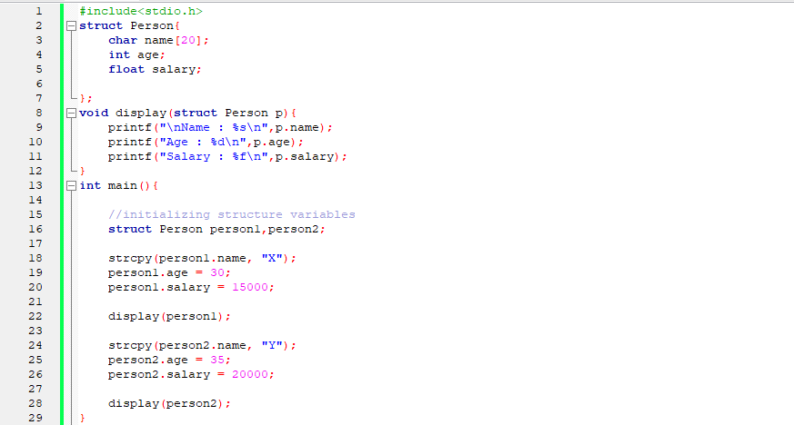
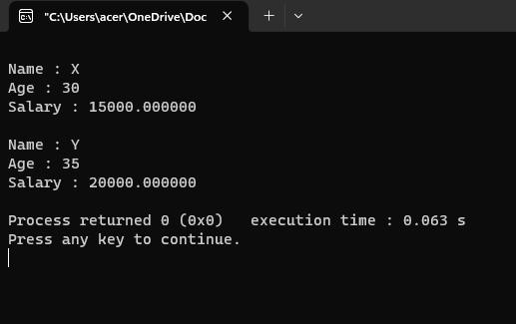
Passing Structures to Functions :

Slide 16
Passing Entire Structures to Functions :
When a structure is used as an argument to a function, the entire structure is passed using the normal call-by-value method.
When using a structure as a parameter, the type of the argument must match the type of the parameter.

Slide 17
Call By Value:
int main(){
int a = 10;
int b = 20;
cbv(a, b) //actual parameter
printf(“a= %d, b = %d”, a,b) ;
}
int cbv(int x , int y) {
x = 20;
y = 10;
}

Slide 18
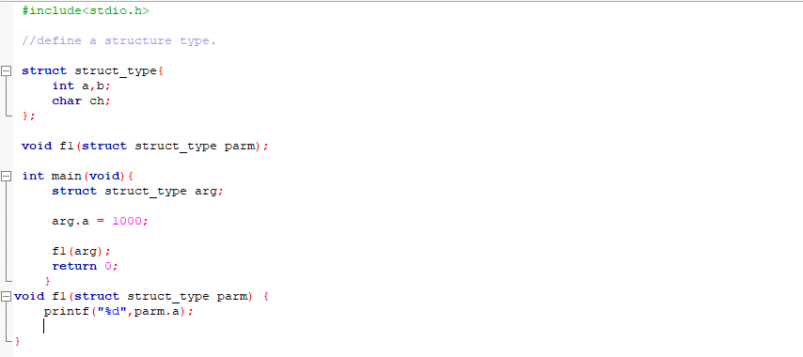
Passing Entire Structures to Functions :

Slide 19
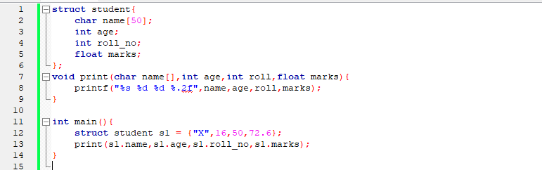
Structure Members as Argument:

Slide 20
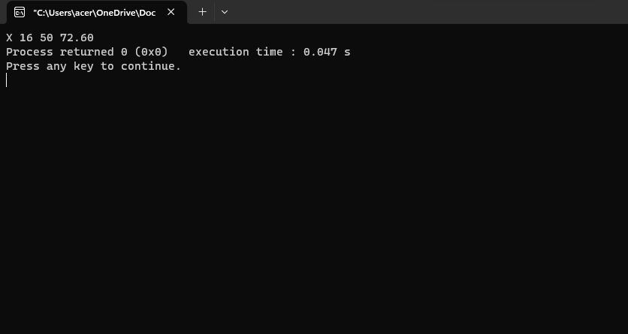
Structure Members as Argument:

Slide 21
Structure Pointers:
C allows pointers to structures just as it allows pointers to any other type of object.
Declaring a Structure Pointers:
struct addr *addr_ pointer;

Slide 22
Using Structure Pointers :
There are two primary uses for structure pointers:
To pass a structure to a function using call by reference
To create linked lists and other dynamic data structures that rely on dynamic allocation.
If the structure contains many members, however, or if some of its members are arrays, run-time performance may degrade to unacceptable levels. The solution to this problem is to pass a pointer to the structure.
To access the members of a structure using a pointer to that structure, we must use the -> operator (arrow operator).

Slide 23
Call By Reference:
int main(){
int a = 10, b = 20;
cbr(&a, &b);
printf(“a = %d, b = % d “,a,b);
}
output: a = 20,b = 10
int cbr (int *x,int *y){
*x = 20;
*y = 10;
}

Slide 24
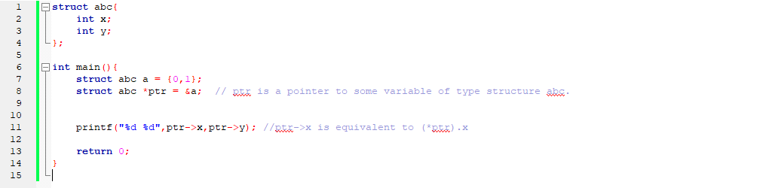
Structure Pointers:

Slide 25
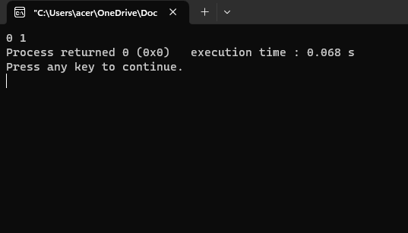

Slide 26
Arrays and Structures within Structures:
A member of a structure can be either a simple variable, such as an int or double, or an aggregate type. In C aggregate types (collection of scaler values like- int, float, pointers) are arrays and structures.
struct x{
int a[10][10];
float b;
} y;
To reference integer 3,7 in a of structure y,
y.a[3][7]

Slide 27
Arrays and Structures within Structures:
When a structure is a member of another structure, it is called a nested structure.
struct emp{
struct addr address; //nested structure
float wage;
} worker;

